Slide 1
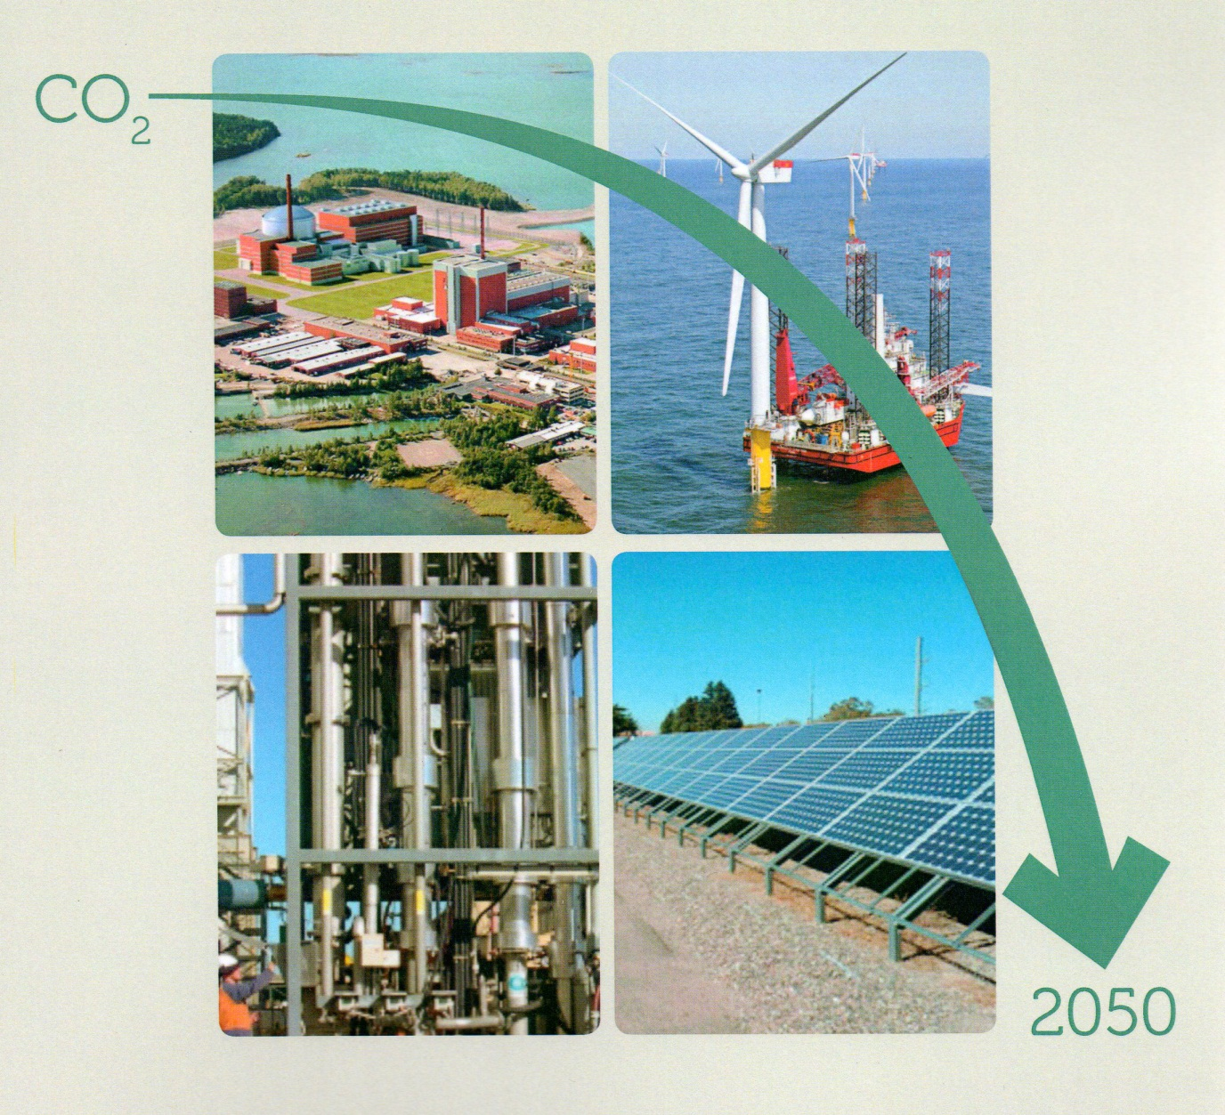
Pathways to 2050:
A UK perspective on feasible energy policies

Slide 2
Pathways to 2050: a UK perspective on feasible energy policies Report of a British Pugwash Working Group
Presentation to the European Energy Conference
in Budapest on 29 November 2013 by:
Dr Christopher Watson – convenor and general editor of the British Pugwash Working Group on ‘Pathways to 2050’
Dr Christine Brown – champion of the ‘High Nuclear’ Pathway
Prof Dave Elliott and Dr David Finney – champions of the ‘High Renewables’ Pathway
Dr Ian Crossland – champion of the ‘Intermediate’ Pathway

Slide 3
Summary
Background to this British Pugwash project
UK Government energy planning 1998-2012
The current UK energy supply system & why it needs to change
Technologies to be considered for future developments
The DECC ‘Pathways to 2050 Calculator’
Presentation of the Pathways developed by our champions:
The High Nuclear Pathway
The High Renewables Pathway
The Intermediate Pathway
Discussion & inter-comparison of the three Pathways
Issues to take into account in reaching a decision
Implications for European and world-wide energy policy
Conclusions and recommendations

Slide 4
Acknowledgements
I am very grateful to
All my colleagues on the British Pugwash Working Group
Our reviewers, most of whose comments have been incorporated into the final report
Sarah Graham-Brown for all her work in preparing the manuscript for publication.
The Network for Social Change for a grant to support the cost of printing and distributing our report.
Copies of our report are available at this meeting. Further copies can be downloaded from our website: http://www.britishpugwash.org/

Slide 5
Objectives of this British Pugwash project
To promote a meaningful public debate about energy policy, particularly in the UK, based on realistic alternatives and defensible numbers.
To present three ‘possible’ Pathways to 2050, which all meet the UK’s international commitments on GHG emissions, and identify the prospects and risks associated with each. Here ‘possible’ means based on technologies which have either:
already reached commercial maturity, or
can be expected to do so in time to be rolled out as planned by 2050.
To emphasise the need for strong government leadership and rapid decisions, because of the urgency of the task.
To avoid being distracted by the uncertainties in climate change modelling.

Slide 6
UK government energy planning 1998-2012
Our report gives a detailed account of the evolution of UK energy policy since 1998.
In broad outline, there have been four phases:
1998-2006 Tony Blair supports early moves towards creating a low-carbon economy, including an expanding renewables programme, and possibly some private sector nuclear ‘new build’.
2007-2008 Gordon Brown gives strong support to inclusion of a nuclear programme, notwithstanding some public concerns.
2008-2009 The Climate Change Act commits the UK to a cut of at least 80% in GHG emissions by 2050.
2009-2012. The government announces a go ahead for 16 GWe of ‘new build’ nuclear power stations, and supports CCS development. DECC published its ‘Pathways to 2050 Calculator’ (of which more later), and a ‘Low Carbon Transition Plan’ (not really a plan)
November 2012 Edward Davey publishes the 2012 Energy Bill, designed to create an ‘Electricity Market’, to help promote private sector take investment.

Slide 7
The current UK energy supply system
The current UK energy system produces some 300 GW of ‘primary’ energy.
105 GW is used to generate ~37 GW of electricity supplied to end users,
175 GW of non-electric end use for heating (~53 GW), transport (~78 GW) & industrial processes (~44 GW)
some 90 GW of primary energy is lost in the process of converting it into usable form.
The primary energy used to generate electricity comes predominantly from:
gas 46%, coal 29%, and nuclear 16%,
all other sources together contribute about 10%.
The end use of electricity is divided between:
12 GW of domestic consumption (heating, cooling, lighting & appliances),
12 GW of industrial use (predominantly metallurgical & heavy engineering),
12 GW of public and commercial consumption
Demand for electrical energy is subject to strong seasonal and diurnal variations – from 20 GW in a hot summer to 60 GW in a cold winter, and by a factor of 60-70% during the course of a typical day.
Balancing supply with demand for both electricity and gas is the responsibility of the National Grid Company, and is managed by special supply contracts and by drawing on energy storage (eg at Dinorwig) and interconnects.

Slide 8
Why does the UK energy system need to change?
Its fossil fuel component generates an unacceptable amount of CO₂. CCS is a possible, but risky, solution to this problem, since this technology has still to be proven commercially at full scale
Our nuclear reactor fleet, which now generates 70% of our low-carbon electricity, is obsolescent. 14 reactors have already been shut down: all but three of the remaining 16 are due to close by 2025.
Our indigenous oil & gas reserves are declining: we already import ~40% of our gas and by 2025 (fracking apart) 70% of our oil and gas could be imported. This would make us uncomfortably dependent on potentially unstable oil & gas exporting countries.
The UK is currently lagging behind several advanced economies in exploiting its potentially rich renewable energy resources
Conclusion: We anticipate that the UK will have to re-build its energy supply infrastructure almost completely during the next 40 years, at a cost of about £3 trillion. This is a heroic, but not utterly unrealistic task.

Slide 9
Technologies to be considered for Pathways to 2050
Improved energy efficiency in the home, industry & commerce
3rd Generation Nuclear Technology - possible candidates are:
EPR (the European PWR developed by Areva, being built in Finland etc)
AP1000 (the Westinghouse PWR now being built in the US & China)
ABWR (the GE-Hitachi BWR being operated in Japan and built in China)
Wind energy – possible candidates are onshore and offshore
Solar energy – possible candidates are PV and solar thermal
Bioenergy – this includes energy crops & agricultural wastes
Wave , tidal stream, tidal range, hydro and geothermal energy
Carbon Capture and Storage (CCS) – there are several variants

Slide 10
The DECC ‘Pathways to 2050 Calculator’
This software tool, developed and made publicly available by the UK Department of Energy & Climate Change (DECC), has been used extensively in our work. It enables the user to develop an energy strategy for the UK, and compute its key parameters, including capacities, emissions & costs. It incorporates a lot of relevant DECC data. The tool has also been used in China, Belgium & South Korea
Our report explains how we have used it, and identifies a few of its weaknesses.
Outputs from the Calculator include useful graphics, reproduced on pp130-136 of our report. Especially useful is the ‘Sankey diagram’ (examples given below) showing the energy flows through the system, and demonstrating energy conservation.
The Calculator requires the user to set 43 parameters, half of which influence energy demand, and the other half the system’s supply mix.
The Calculator shows that all three British Pugwash Pathways achieve the required 80% reduction in GHG emissions by 2050

Slide 11
Selection of values for key input parameters for the DECC Calculator
1. little or no attempt is made to decarbonise or change – “do nothing”
2. ambitious but reasonable
3. very ambitious level of effort that is unlikely to happen without significant change from the current system
4. extreme upper end of what is thought to be physically plausible by the most optimistic observer
DECC Calculator “levels” ie possible choices

Slide 12
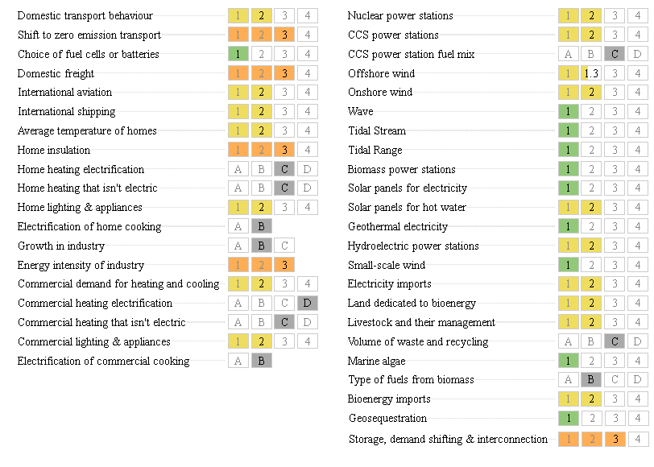
The 43 input parameters of the DECC Calculator, with a typical set of choices
DEMAND SUPPLY

Slide 13
An example of output from the DECC Calculator A typical Sankey Diagram
Intermediate Pathway

Slide 14
The High Nuclear Pathway Developed by Christine Brown, our High Nuclear champion
Key characteristics of this Pathway
It meets the 80% reduction target for GHG emissions by:
a relatively modest (overall 20%) reduction in demand from end-users, (led by a 25% reduction in transport and 33% in industry) and
almost complete electrification of supply, using low carbon generators , which leads to a 71% increase in total electric demand, dominated by a six-fold increase for transport
It has a credible mixture of primary energy sources
58% of Nuclear energy – ie extending the UK’s current ‘new build’ programme up to 2050
21% of Fossil fuels (oil 16%, gas 5%), with CCS in all fossil-fuelled power stations
20% of Renewables (9% biofuels, 8% environmental heat, 2% wind, 1% solar)
It ensures a high level of achievability and public acceptability by:
using proven 3rd-generation NPPs, with replication of standard international designs, and re-creation of a strong UK capability in nuclear technology and manufacture
using CCS and renewables only in applications where they are strongly beneficial
emphasising safety, reliability, and compliance with non-proliferation commitments

Slide 15
High Nuclear Pathway Electricity Supply Breakdown
Electricity Supply | 2010 | 2050
 | % | %
Unabated Thermal | 80.7 | 0.0
Nuclear Power | 14.0 | 74.5
CCS | 0 | 17
Off Shore Wind | 1.1 | 6.2
On Shore Wind | 2.9 | 1.4
Hydro | 1.3 | 0.8
Tidal and Wave | 0 | 0
Geothermal | 0 | 0
Solar PV | 0 | 0
TOTAL SUPPLIED TO GRID | 43.3 GW av | 86 GWav
Table 4.4 Cf. TOTAL ELECTRICITY DEMAND IN 2050 of 68.6 GWav

Slide 16
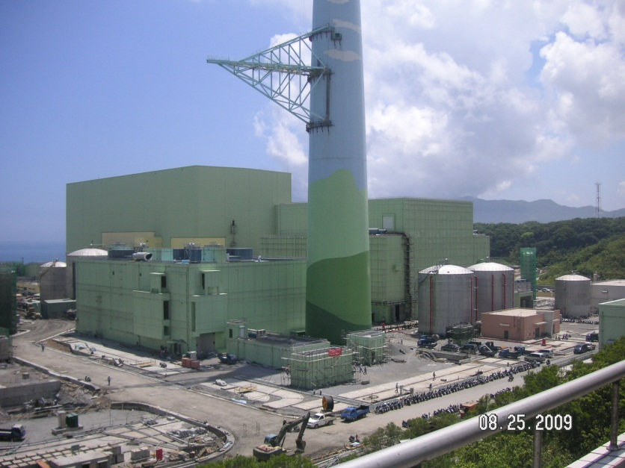
HIGH NUCLEAR PATHWAY New Build
EPR Under Construction
Olkilouto, Finland
2nd under construction at Flamanville
ABWR under Construction
Lungmen, Taiwan
4 ABWR units in operation
4 ABWR under construction
The UK has now agreed with EDF to build 2 EPR units (!.6 GWe each) at Hinkley Point C. This is intended to the first plant of the ‘new build’
Programme, giving 16 GWe from plants at 8 sites

Slide 18
HIGH NUCLEAR PATHWAY Spent Fuel Management
Thermal reactor fuel has a useful life of 3 to 7 years.
After discharge from the reactor it is initially cooled under water in local storage ponds.
After 9 -12 months two alternative management options can be considered, depending on fuel cycle chosen:
Open cycle - spent fuel disposed of directly in a GDF
Closed - spent fuel recycled to generate more energy
The infrastructure requirements are very different, and this choice requires careful planning from the outset

Slide 19
HIGH NUCLEAR PATHWAY Fuel Cycle options
SUSTAINABLE USE OF UK RESOURCES
Source: US DOE Energy Information Administration International Energy Outlook 2004, DOE/EIA-0484(2004). Note: Gas and Oil include speculative reserves; Coal and Uranium do not.

Slide 20
HIGH NUCLEAR PATHWAY CONCLUSIONS
Delivers energy security with the required 80% reduction in Greenhouse gas emissions by 2050
The clock is ticking fast – UK needs to act now
Nuclear power has the potential to ensure energy security for many years beyond 2050, but it requires proper management of the spent fuel
Requires 27 3GWe reactors to be built within the next 40 years – history supports such a build rate
The technology exists and is tried and tested
Can we afford to ignore this clean, secure source?

Slide 21
The High Renewables Pathway Developed by Dave Elliott and David Finney, our High Renewables champions
The UK has an exceptionally large potential renewable energy resource, which has recently been estimated at 256 GWav (Marine 197 GWav, Land-based 59 GWav) .
It is not easy to define a single high renewables pathway for the UK now, because of the enormous range of possible technologies at various stages in development in the UK and elsewhere.
Candidates include Wind, Wave, Hydro, Tidal, Solar, Biomass and Geothermal.
A number of countries are moving towards the goal of 100% renewables. Some 8 EU countries have decided not to pursue the nuclear option further.
However: most of the renewable alternatives currently fall short of the Pugwash project criteria that :
they should have already reached commercial maturity, or
can be expected to do so in time to be rolled out as planned by 2050.

Slide 22
Total energy supply in our chosen High Renewables Pathway for 2050
Energy source Installed Capacity Output Comment
GWn GWav
Offshore wind 76 34 About half of Poyry⁽¹⁾
On-shore wind 31 9
Solar (PV & thermal) 41 9 Tidal stream/wave/hydro 35 10
Environmental heat 7 7
Biomass & waste 38 38
Geothermal 4 3
Total Renewables 232 110
Non-renewable 51 51 Still some fossil fuel ⁽²⁾
Total energy produced 283 161 Includes 28GWav of exports⁽³⁾
Within this total, the electrical supply component is 76 GWav
Pöyry (2011) ‘Analysing technical constraints on renewable generation to 2050’, Pöyry consultants report to the UK Committee on Climate Change, March http://hmccc.s3.amazonaws.com/Renewables%20Review/232_Report_Analysing%20the%20technical%20constraints%20on%20renewable%20generation_v8_0.pdf
The DECC Calculator forces retention of some fossil fuels, because it does not allow conversion of surplus electricity to ‘green’ fuels
This is our chosen solution to the problem created by the intermittency of renewables. It incidentally leads to a major source of income to the UK

Slide 23
Gas
Coal

Slide 24
Pugwash High Renewables- DECC calculator
Excess wind generation exported via 15GW inter-connector

Slide 25
DECC Sankey diagram for High Renewables
Notes
1.The DECC software won’t let us replace all the fossil fuel with renewables. We wanted to use some of the excess electricity from wind generation to make hydrogen for use in backup plants rather than fossil fuel. The DECC Calculator simply exports it all.
2.This Sankey diagram illustrates the very low energy losses in this Pathway.

Slide 26
Some key features of the High Renewable Pathway
It envisages a 40% cut in total end use of energy by 2050, if losses and energy exports are excluded. This is an ambitious but not impossible target.
It only uses about 30% of the available UK renewable electrical energy resource.
As regards non-electric primary energy, the planned use of 81 GWav made up of 13 GW of Solar hot water from panels on roofs, 7 GW of Pumped environmental heat, and 61 GW of heat output from Biomass CHP power stations, is modest compared with plans in other European countries (eg Finland, Sweden and Denmark)
It uses ~10% of UK land area for the cultivation of biocrops by 2050. This is a large increase, but is perhaps a defensible figure if account is taken of improvements in agricultural practice.

Slide 27
High Renewable Pathway conclusions
The Pathway balances total energy supply and demand, using renewables for nearly all needs, with no biomass imports
Even allowing for the intermittency of some renewables, total supply meets demand, with no need for fossil back up
Cumulative emissions are within the 2050 target, and are significantly lower than those of the other Pathways in 2030
The total cost up to 2050 is very similar to the other Pathways, but the investment could give a net income to the UK from electricity exports of ~£15.6 billion p.a.
If a wind-to-gas conversion option were taken, the Pathway could be 100% renewable, with no dependence on fossil fuels

Slide 28
The Intermediate Pathway Developed by Ian Crossland, our Intermediate champion
Key characteristics of this Pathway
It meets the 80% reduction target for GHG emissions by:
A 21% reduction in end-user demand (led by transport 31%, industry 33%)
Electrification of supply, using low carbon electricity generators , leading to an 81% increase
It uses a credible mixture of primary sources:
It largely exclude small output sources, especially where they still need a lot of development
It avoids over-ambitious rates of deployment of CCS & nuclear
It ensures a high level of achievability by:
avoiding over-ambitious reductions in energy demand
eliminating relatively un-tested technologies
It keeps standby generation down to ≤10% of total capacity

Slide 29
Approach to achieving these aims
Reduction in demand
All input parameters affecting energy saving set at level 2 except for four, which were set at the “very ambitious” level 3 (Shift to zero emission transport, Domestic freight, Home insulation and Energy intensity of industry).
Electrification of supply
Home heating set at level 3 and Commercial heating at level 4.
Using low carbon electricity generators
We have set the ‘supply’ parameters so as to achieve a roughly equal spread of primary supply over nuclear, renewable and fossil fuels with CCS
Selection of primary sources
We have largely excluded wave, tidal, solar PV and geothermal inputs
Ensuring a high level of achievability
We have not sought to exceed a 20% reduction in end use of energy
We have kept growth of nuclear down to 30 GWe and wind down to 13 GWav by 2050
We have made large increases in biomass (28 GW) and environmental heat (28 GW), so as to permit power plants with CCS to contribute significant ‘negative emissions’

Slide 30
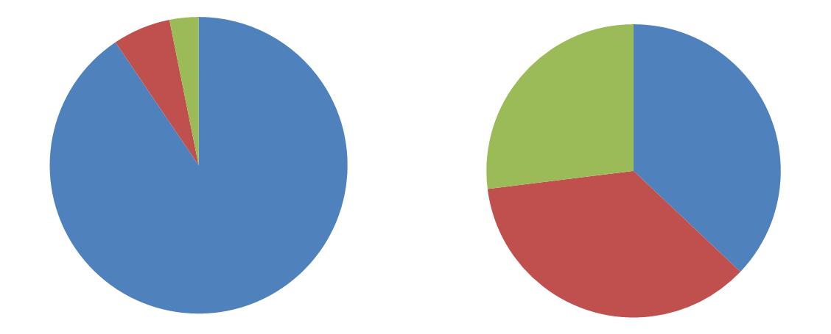
Intermediate pathway Balance of primary supply
2010
2050
Blue – fossil fuels
Red – nuclear
Green - renewables

Slide 31
Intermediate pathway Conclusions
A roughly equal combination of CCS, nuclear and renewables enables the 80% reduction in GHG emissions to be met by 2050
A few “very ambitious” targets were set for energy savings, but no “heroic” (level 4) targets
An essential element of our pathway is the use of biofuels with CCS to produce “negative” emissions. Without this, the 80% reduction cannot be met

Slide 32
A comparison of the three Pathways High Nuclear (HN), High Renewables (HR) and Intermediate (Int)
All three Pathways achieve some reduction in end-user demand by 2050 (HN and Int ~20%, HR ~40%). Large reductions are controversial.
All three approximately double the electrical energy supplied, because of end-use electrification, but the HR electrical capacity is much higher, so as to give a reserve to cope with renewables intermittency
Two of the three Pathways expand the Nuclear fleet significantly beyond the immediate ‘new build’ scale (HN 80 GWe, Int 39 GWe). The third eliminates it altogether.
All three Pathways include some renewable energy capacity, but the amounts vary greatly (HN 18 GW, Int 40 GW, HR 181 GW)
All three include some CCS (HR 2 GW, HN 21 GW, Int 51 GW)
All three achieve the 80% reduction in emissions by 2050, but the HR Pathway achieves reductions earlier, because it has no nuclear build
All three Pathways are estimated to cost £3 trillion over the period 2010-2050. Cost differences between them are less than the uncertainties.

Slide 33
Issues to take into account in reaching a decision
Technical risk:
Nuclear – none of the 3rd generation designs under consideration is yet fully proven
Renewables – apart from onshore wind (which has land use and public acceptability issues), none of the technologies are yet fully commercially competitive
CCS – there is as yet no full-scale commercial plant anywhere in the world, and there are uncertainties about its infrastructure requirements
Commercial risk: trends in the cost of all the relevant technologies are hard to predict
UK industrial infrastructure: we have lost much of our historic nuclear capability, and have not yet created a capability for rapid manufacture of renewable or CCS technology on the required scale

Slide 34
Issues to take into account in reaching a decision continued
Safety issues: a major nuclear disaster has occurred somewhere in the world about once every decade. There is also ongoing public concern about radioactive waste disposal.
Environmental issues: biocrop and onshore wind make high demands on UK land (10% and 1% respectively of the UK land area for the High Renewables Pathway). Extensive industrial activity on upland peat areas would threaten its ability to sequester CO_{2.}
Nuclear non-proliferation commitments: the UK has a special position as a Nuclear Weapon state
International trade: potentially beneficial, but the UK needs to position itself to benefit from the new energy market
Public opinion and national politics: recent polls have sent ambiguous signals about public preferences and concerns. There is as yet no cross-party political consensus about the right way forward. The only universal message seems to be ‘not in my back yard’.

Slide 35
Implications for European and world-wide policy
The countries of Europe all have different energy resources, technical, economic & political histories. It is hard to reach consensus
The EU is encouraging/ imposing, some degree of commonality
We all share a common concern about Greenhouse Gases, but we do not all have the same commitment to achieve large reductions. The advent of fracking has complicated the task of reaching consensus on this
We have drawn widely diverging conclusions from Fukushima
The current level of electrical interconnection between countries is quite small: commerce in fossil fuels is much larger, but raises political issues
The High Renewables advocates in the UK would like to increase interconnection substantially to help solve the problem of intermittency. Will this be acceptable?
Although individual nations can set an example, the problem of Global Warming can only be solved by International action
The timescale on which this action is required is uncomfortably short compared with the timescale for decision-taking on major energy investment. Leaving it all to ‘the market’ may slow down action to an unacceptable extent

Slide 36
Conclusions and recommendations
During the next 40 years, the UK will have to rebuild its energy infrastructure almost completely, at a cost of ~ £3 trillion. This is a heroic, but not completely unrealistic task.
There is no public or cross-party consensus in the UK about the technologies which should be used, and no clear government lead. Decisions are urgently needed, because of the imminent climate change threat.
British Pugwash has put forward three very different Pathways, each of which draws on a broadly ‘credible’ set of technologies, has a roughly similar cost, and meets the UK commitment to reducing its GHG emissions by 80% by 2050.
Each Pathway has advantages and risks, and the decision between them needs to be taken by exercising judgement on the probabilities, taking account of both quantifiable and unquantifiable issues.
We urge the UK government to exercise leadership, and to come forward with a single plan with:
named technologies,
target dates for the construction of full-scale commercial plants of the chosen types,
a management team capable of implementing that plan, and
a set of government-funded inducements to the private sector to play its part in implementation.
We hope that this report will encourage a prompt public debate on UK energy policy, and that other countries may also get drawn into this debate

Slide 38
HIGH NUCLEAR PATHWAY Energy Demand
Energy Demand From | 2010 | 2050 | % change from 2010 to 2050
 | GWav | GWav
Lighting & Appliances | 19.5 | 21.1 | +8%
Heating & Cooling | 57.8 | 54.7 | -5%
Transport | 80.1 | 60.2 | -25%
Industry | 58.9 | 39.6 | -33%
Agriculture | 1.3 | 1.3 | 0
TOTAL | 217.6 | 176.8 | -19%
Table 4.1 TOTAL ENERGY DEMAND FALLS BY 19% BY 2050

Slide 39
High Nuclear Pathway Electricity Demand
Electricity Demand | 2010 | 2050 | % Change
 | GWav | GWav | %
Lighting & Appliances | 17.7 | 21.1 | +19
Heating and Cooling | 6.5 | 16.7 | +156
Transport | 0.9 | 7.2 | +687
Industry | 15.1 | 23.1 | +153
Agriculture | 0.5 | 0.5 | +7
Table 4.3 TOTAL | 40.2 | 68.6 | +71%
TOTAL ELECTRICITY DEMAND INCREASES BY 71%

Slide 40
Table 4.2 High Nuclear Pathway Primary Energy Breakdown
Primary Energy | 2010 | 2050
 | % | %
Natural gas | 38 | 5
Oil | 34 | 16
Coal | 18 | 0
Wind | 1 | 2
Nuclear | 6 | 58
Bioenergy | 2 | 9
Solar | 0 | 1
Environmental Heat | 0 | 8
Hydro | 1 | 0
Wave | 0 | 0
Geothermal | 0 | 0

Slide 41
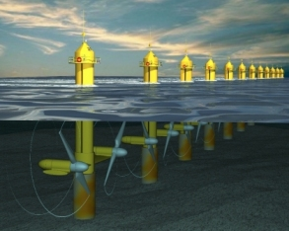
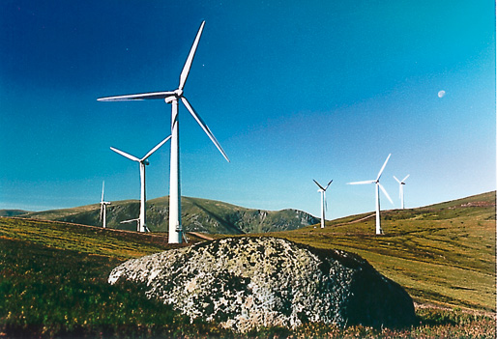
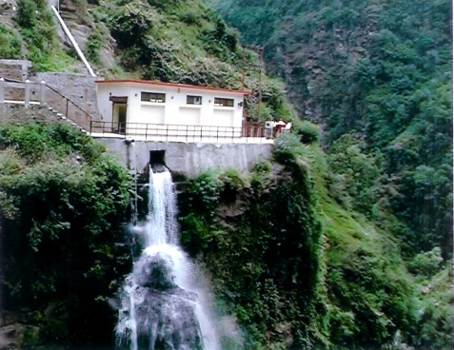
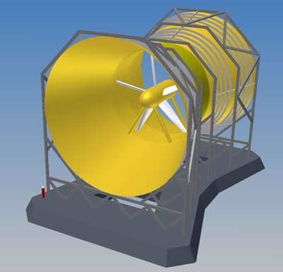
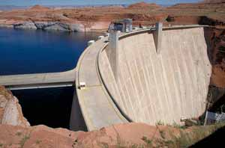
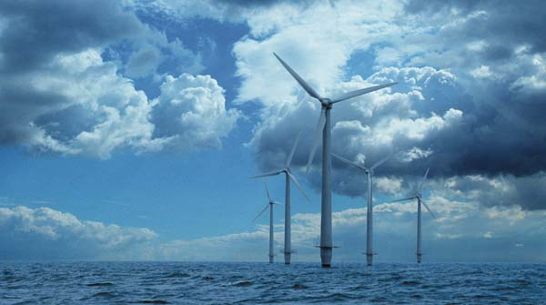
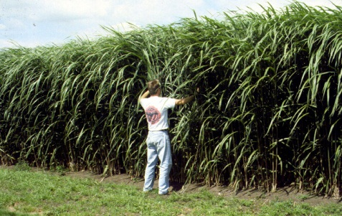
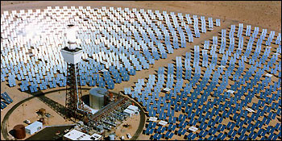
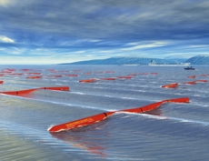
Tidal Wind Solar Hydro
1kW PV array
Mini hydro-MW
2MW turbines in an offshore wind farm
Macro hydro-GW
Tidal 2MW unit
Wave
Biomass
CSP

Slide 42
Marine renewable energy: 197 GWav: Offshore Wind 175 GW Tidal stream 13 GW Wave 5 GW Tidal range 4 GW ‘Offshore Valuation’, Public Interest Research Centre www.offshorevaluation.org/ Land-based renewable energy: 59 GWav Onshore wind 15 GW Hydro 4 GW Solar PV on roofs 16 GW Biomass 20 GW Geothermal 4 GW http://2050-calculator-tool.decc.gov.uk/assets/onepage/5.pdf - /11.pdf Total Renewable Electrical Energy Resource: 256 GWav
The UK renewable electrical energy resource
Some recent estimates

Slide 43
The UK renewable non-electrical energy resource Some recent estimates
Solar hot water panels on roofs 13 GW
Pumped environmental heat 7 GW
Biomass CHP power stations heat output 61 GW
Total non-electrical energy resource 81 GWav
It should be noted that the UK is well behind other European countries in its use of CHP and DH.
Around 60% of Denmark’s domestic/commercial heat is supplied by CHP plant, fired by a mixture of fossil fuel & biomass. It plans for 40% of this to be solar fed by 2050, with inter-seasonal heat stores.
About 60% of the total energy input for Stockholm’s Central Heat Network is provided by heat pumps, with a total heat supply capacity 420 MW(th).
Over 93% of Helsinki’s heat comes from a heat pump plant, feeding its district heating network.

Slide 44
Bio-energy in the High Renewables Pathway
Inputs:
Land-based bio-energy materials 21 GW
Agricultural & other wastes 17 GW
Processes:
Bio-conversion to solid (30) & gaseous (5) fuels
Conversion losses 2 GW
End uses:
Heat generation for domestic, commercial & industrial purposes 17 GW
Fuel for CHP plants 13 GW
Land use implications: biocrops foreseen to use 10% of UK land area. This is perhaps a defensible figure if account is taken of improvements in agricultural practice.

Slide 45
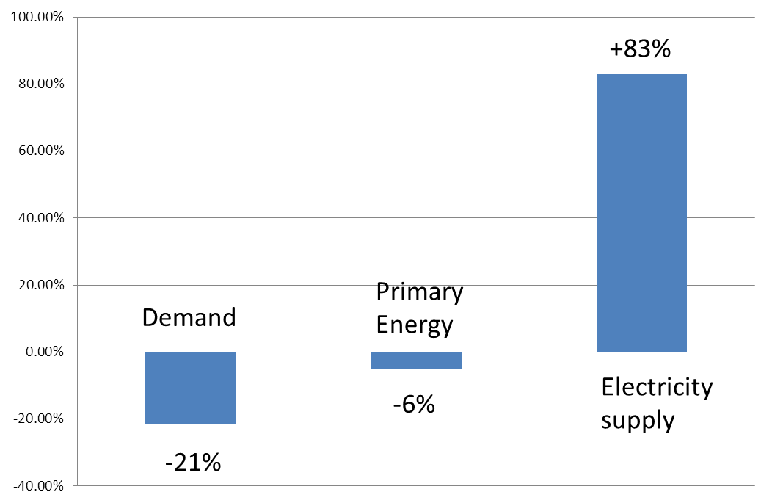
Change in energy demand & supply 2010 to 2050

Slide 46
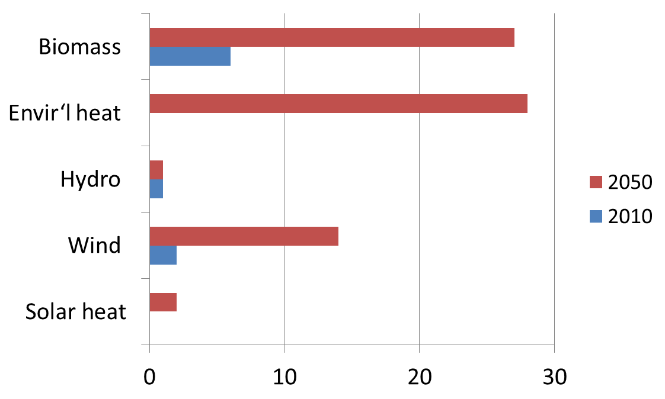
Intermediate pathway Composition of renewables
GWav

Slide 47
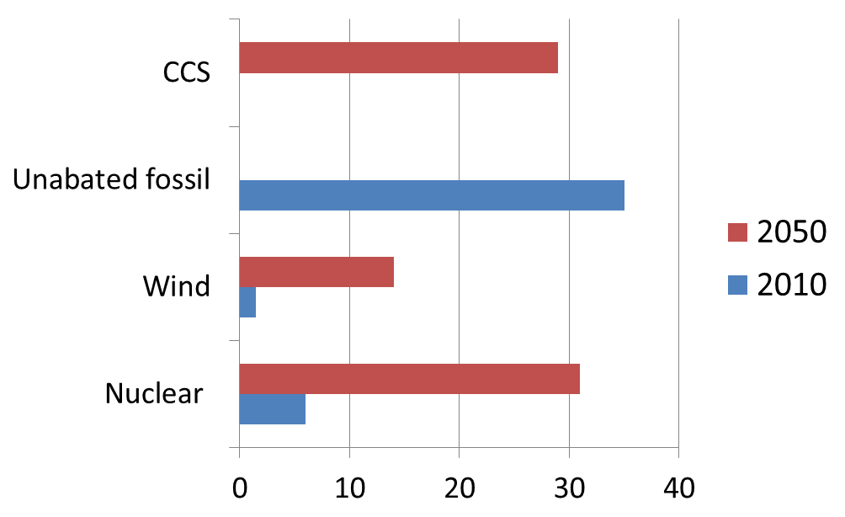
Intermediate pathway Electricity production 2010 & 2050
GWav

Slide 48
Electricity supply provided by the three Pathways
Electricity demand from | 2010 |  |  | 2030 |  |  | 2050
 | HN | HR | Int | HN | HR | Int | HN | HR | Int
 | GWav | GWav | GWav | GWav | GWav | GWav | GWav | GWav | GWav
Lighting & Appliances | 17.7 | 16.1 | 17.7 | 18.7 | 12.9 | 18.7 | 21.1 | 11.1 | 21.3
Heating & Cooling | 6.4 | 6.2 | 6.4 | 9.9 | 4.4 | 10.3 | 16.7 | 3.8 | 17.8
Transport | 0.9 | 0.9 | 0.9 | 5 | 5.2 | 5 | 6.1 | 7 | 6.9
Industry | 14.6 | 14.6 | 14.6 | 17.9 | 17.9 | 17.9 | 23 | 23 | 23
Agriculture | 0.5 | 0.5 | 0.5 | 0.5 | 0.5 | 0.5 | 0.5 | 0.5 | 0.5
Transmission losses | 3 | 2.9 | 3 | 3.9 | 3.1 | 3,9 | 5.1 | 3.4 | 5.2
Export |  |  |  | 1 | 2.3 |  | 13.8 | 26.9 | 4.6
Total incl exports & losses | 43.1 | 41.2 | 43.1 | 56.9 | 46.3 | 52.4 | 86.3 | 75.7 | 79.3
% of 2010 values | 100% | 100% | 100% | 132% | 112% | 122% | 200% | 184% | 184%

Slide 49
Overall Energy demand reduction achieved in the three Pathways
Overall Energy demand from | 2010 |  |  | 2030 |  |  | 2050
 | HN | HR | Int | HN | HR | Int | HN | HR | Int
 | GWav | GWav | GWav | GWav | GWav | GWav | GWav | GWav | GWav
Lighting & Appliances | 19.5 | 18 | 19.5 | 19.5 | 14.7 | 20 | 21.1 | 12.6 | 21.1
Heating & Cooling | 57.7 | 56.6 | 57.7 | 53 | 43.5 | 53 | 54.7 | 38 | 54
Transport | 80.1 | 78.6 | 80.1 | 61.5 | 48.8 | 58 | 60.2 | 35.3 | 55.2
Industry | 58.9 | 58.9 | 58.9 | 45.4 | 45.5 | 45 | 39.6 | 39.6 | 39.6
Agriculture | 1.2 | 1.2 | 1.2 | 1.3 | 1.2 | 1 | 1.3 | 1.2 | 1.3
Total excl export & losses | 217.4 | 213.3 | 217.4 | 180.7 | 153.7 | 177 | 176.9 | 126.7 | 171.2
% of 2010 values | 100% | 100% | 100% | 83% | 72% | 81% | 81% | 59% | 79%

Slide 50
Electricity supply provided by the three Pathways
Electricity demand from | 2010 |  |  | 2030 |  |  | 2050
 | HN | HR | Int | HN | HR | Int | HN | HR | Int
 | GWav | GWav | GWav | GWav | GWav | GWav | GWav | GWav | GWav
Lighting & Appliances | 17.7 | 16.1 | 17.7 | 18.7 | 12.9 | 18.7 | 21.1 | 11.1 | 21.3
Heating & Cooling | 6.4 | 6.2 | 6.4 | 9.9 | 4.4 | 10.3 | 16.7 | 3.8 | 17.8
Transport | 0.9 | 0.9 | 0.9 | 5 | 5.2 | 5 | 6.1 | 7 | 6.9
Industry | 14.6 | 14.6 | 14.6 | 17.9 | 17.9 | 17.9 | 23 | 23 | 23
Agriculture | 0.5 | 0.5 | 0.5 | 0.5 | 0.5 | 0.5 | 0.5 | 0.5 | 0.5
Transmission losses | 3 | 2.9 | 3 | 3.9 | 3.1 | 3,9 | 5.1 | 3.4 | 5.2
Export |  |  |  | 1 | 2.3 |  | 13.8 | 26.9 | 4.6
Total incl exports & losses | 43.1 | 41.2 | 43.1 | 56.9 | 46.3 | 52.4 | 86.3 | 75.7 | 79.3
% of 2010 values | 100% | 100% | 100% | 132% | 112% | 122% | 200% | 184% | 184%

Slide 51
EU Renewable energy supply and targets % of Gross energy consumption 2010 supply 2020 agreed targets Sweden 47.6 49 Latvia 33.1 40 Finland 33.0 38 Austria 30.9 34 Portugal 26.8 32 Estonia 25.6 25 Romania 24.1 24 Denmark 23.5 30 Slovenia 18.5 25 Lithuania 18.3 23 Spain 15.1 20 France 13.3 23 Bulgaria 12.8 16 Germany 12.3 18 Greece 11.2 18 Italy 11.2 17 Poland 10.6 15 Czech Republic 10.4 13 Slovakia 9.5 14 Hungary 8.2 13 Ireland 6.1 16 Cyprus 6.0 13 Belgium 5.6 13 Netherlands 4.4 14 United Kingdom 3.8 15 Luxembourg 2.8 11 Malta 0.4 10
Austria, Finland, France, Portugal, Spain and Sweden do have large hydro resources. But the UK has the best wind, wave, tidal resources in the EU. How come we are near the bottom of the league table?
Source: Eurobserver 2012

Slide 52
100% from renewables by 2050 EU: The European Climate Foundation www.roadmap2050.eu. European Renewable Energy Council www.rethinking2050.eu PriceWaterhouseCoopers www.pwc.co.uk/eng/publications/ 100_percent_renewable_electricity.html Global: Stanford University- Prof. Mark Jacobson www.stanford.edu/group/ efmh/jacobson/sad1109Jaco5p.indd.pdf WWFwww.wwf.org.uk/research_centre/research_centre_results.cfm?uNewsID=4565
Plus 60 more studies/papers: www.mng.org.uk/gh/scenarios.htm

Slide 53
Hydrogenics

Slide 54
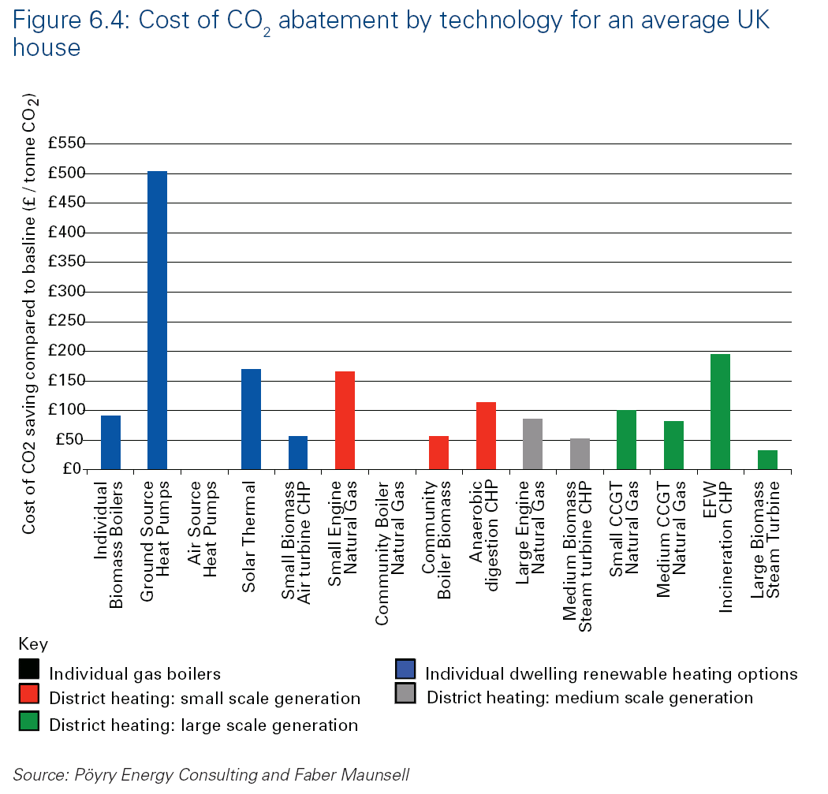
Community-scaled CHP/DH not domestic Heat Pumps
Large NG Boilers/ASHP data not included

Slide 55
Aims of the Intermediate Pathway
80% reduction in GHG emissions on 1990 levels by:
Reduction in demand
Electrification of supply coupled with low carbon electricity generators
High level of achievability
Mixture of high output sources - general rejection of small output sources especially where they need a lot of development (PV, geothermal, small scale wind etc)
More ambition with respect to energy demand than supply
Standby generation ≤10% of total capacity

Slide 56
DEMAND SUPPLY

Slide 57
Reduction in demand at 2050
Demand at 2050 reduced by 21.5% on 2010 as a result of four “very ambitious” (i.e. Level 3) choices:
Reduction in demand comes primarily from
Transport -31%
Industry -33%

Slide 58
Change in energy demand & supply 2010 to 2050

Slide 59
Intermediate pathway Balance of primary supply
2010
2050
Blue – fossil fuels
Red – nuclear
Green - renewables

Slide 60
Intermediate pathway Composition of renewables
GWav

Slide 61
Intermediate pathway Electricity production 2010 & 2050
GWav

Slide 62
Intermediate pathway Conclusions
A roughly equal combination of CCS, nuclear and renewables enables the 80% reduction in GHG emissions to be met. Pathway is broadly similar to NGC, Markal
Some “very ambitious” targets for energy savings but no heroic assumptions
An essential element is the use of biofuels with CCS to produce “negative” emissions. Without this, the 80% reduction cannot be met

